Slide 1
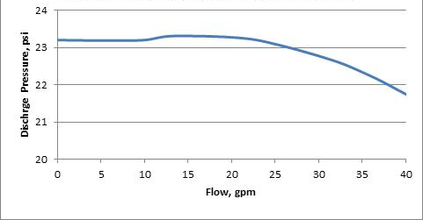
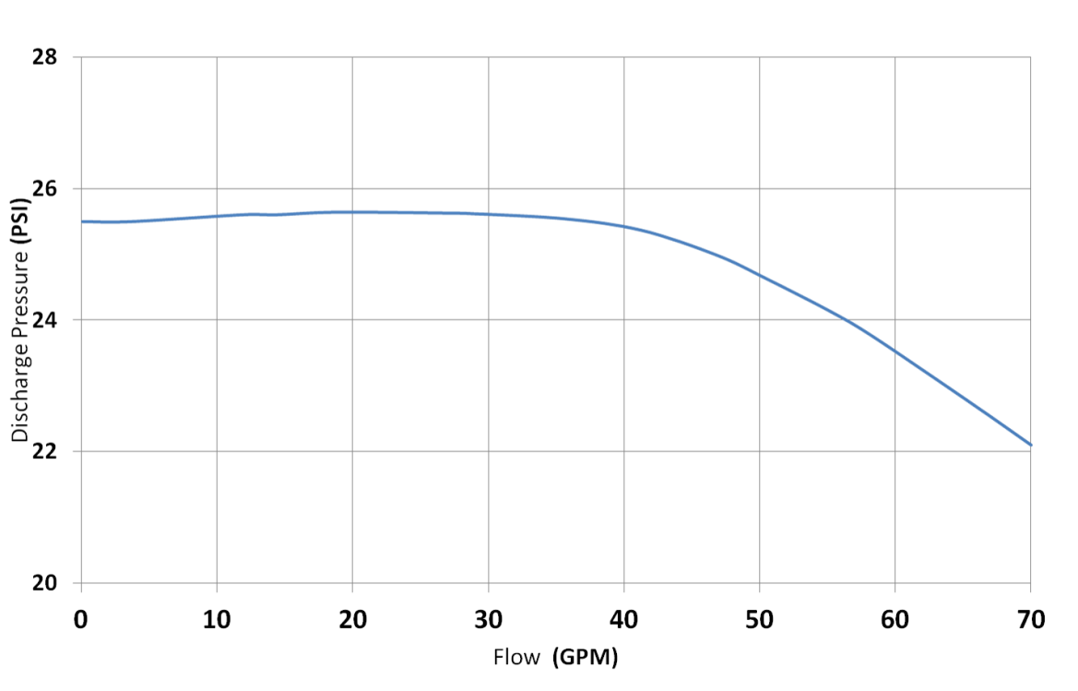
Hayward PPAP 1000 (1.0 HP) Pump Performance
Hayward PPAP 1500 (1.5 HP) Pump Performance

Slide 2
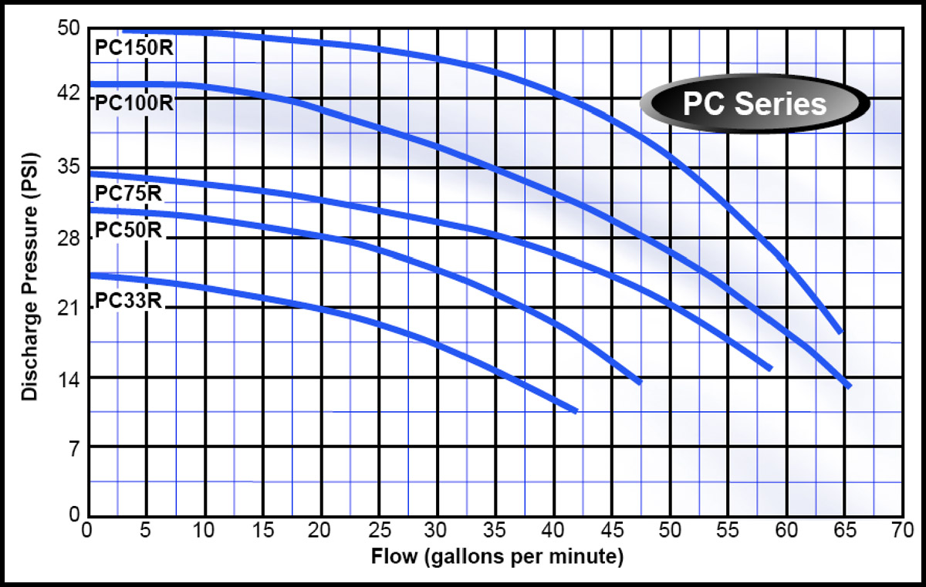
Webtrol Pump Performance
Webtrol Delivery Curve
PC100R = 1 HP
PC150R = 1.5HP

